Slide 1

Predicting AirBnB Prices for New York City
By Jun Chen

Slide 2

Why New York City?
Known as the Big Apple, New York City is one of the world’s most famous cities, and draws million of visitors every year:
54.4m 2014
55.9m 2015
60.5m 2016
62.8m 2017
65.2m 2018
One of the United State’s most historic cities, and home of a large number of cultural landmarks

Slide 3

Why AirBnb?
One of the biggest rental companies out there, offering unique experiences and a wide range of options.
Availability. AirBnB’s public data is aggregated and published via insideairbnb.com
From my personal experience it is a very flexible tool for travelers.

Slide 4
Methods
Data Cleaning and analysis
Data Exploration
Hypothesis Testing
Machine Learning
Linear Regression
Ridge Regression
Random Forest Regresion

Slide 5
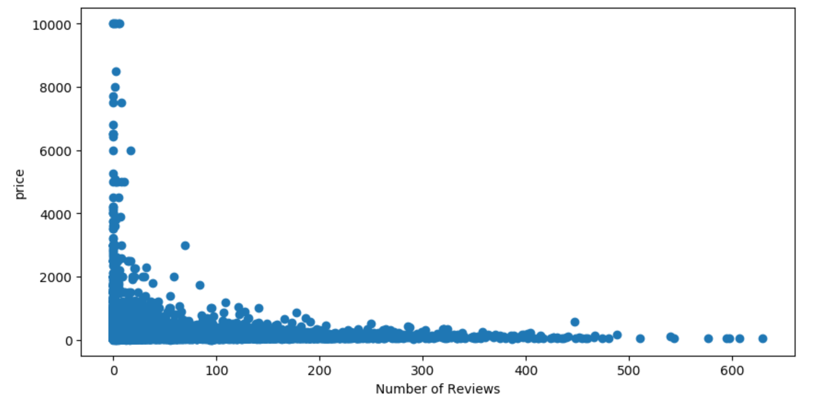
Initial Findings
Based on initial explorations, there are number of variables that may have a significant effect on the price for an AirBnB in NYC:
Date listed
Reviews per month
Number of Reviews

Slide 6
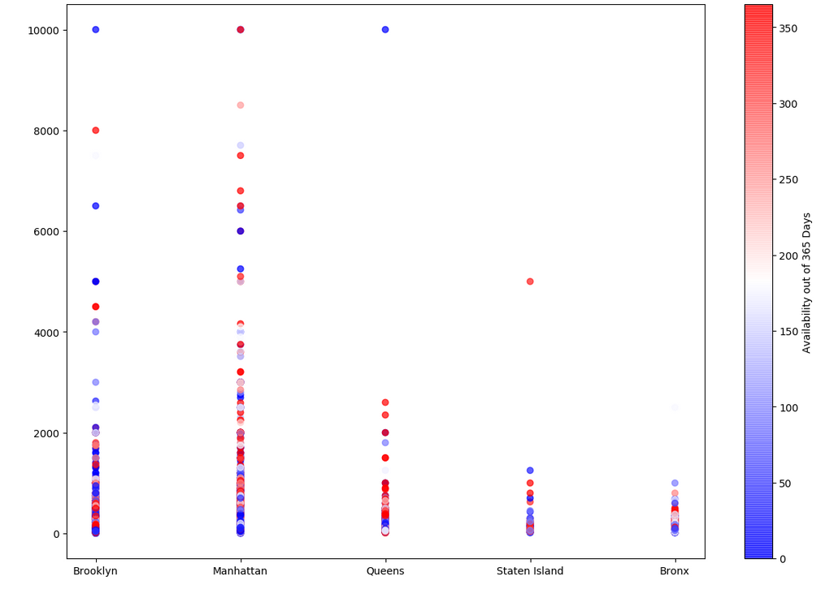
Neighborhood with the most availability
Manhattan and Queens are the two neighborhoods with the best availability, followed by Brooklyn, Bronx, and Staten Island

Slide 7
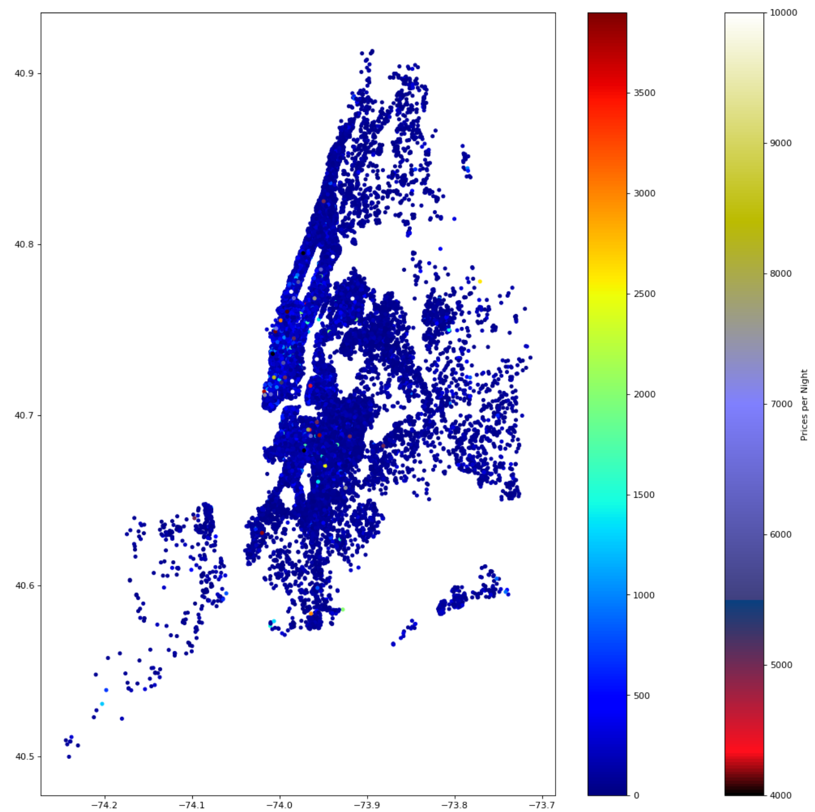
Price by Neighborhood
Judging from our heatmap here, the highest priced AirBnB listings are in Brooklyn and Manhattan, followed by Staten Island, Bronx and Queens

Slide 8
Statistical Analysis
Traditionally the price to rent a unit is most expensive then renting a room/sharing with a cotenant. However, New York City is one of the most expensive cities in the world and depending on the neighborhood this may not hold truth.
The null hypothesis (Ho) as there is no difference between the price for a whole apartment and a room in NYC.
Alternative hypothesis (H1) is that renting a room in NYC is less expensive

Slide 9
Statistical Analysis
To complete the analysis, I pulled data from the ‘Price’ column of the data set, and separated it by ‘Private room’ and ‘Entire home/apt’ , using “l = df.price[df.room_type == 'Private room']
m = df.price[df.room_type == 'Entire home/apt']”. As we have all the data from Airbnb, circa 2017 - 2019 for the NYC area, it is assumed that we have a full population, and thus for my analysis, I will use the Z score instead of the T score
Employed ztest_ind()
After running our formula, the results we received was tstat = 58.631293966982135, with a p value of 0.0. Interpreting our results, due to the small p value, we will reject the null hypothesis here that the cost is the same in NYC for whole apartments and single rooms. In terms of our analysis we can conclusively say that there is a difference in cost between renting a whole apartment and renting a single room.

Slide 10
Results and In-Depth Analysis Linear Regression Model
Machine Learning with Linear Regression Model
Continuous Variables when tested with the .score function has shown to have low accuracy.
Highest individual score was ~ 0.0022
Multivariate Linear regression was performed with the variables ['minimum_nights', 'latitude', 'longitude', 'number_of_reviews', 'reviews_per_month', 'availability_365', 'time_since_collection’]
There was an significant increase in our accuracy score (high of ~0.054) after a number of tests.
While there was a significant change, a score of 0.054 is still extremely small for a prediction model

Slide 11
Results and In-Depth Analysis Ridge Model
Due to the low accuracy scores provided by our Linear Regression Model, I attempted to improve my model by testing several variations (Ridge, Lasso, Elastic Net)
Regular Linear Regression 0.05533730706618012
Ridge Regression 0.05543737571257201
Lasso Regression 0.03909130532326177
Elastic Net 0.014349409345878916
From the scores provided above, the only model that provided an improvement was our Ridge Model, with a 0.001 difference between the two. My next step was to fine tune the model via the hyperparameters.

Slide 12
Results and In-Depth Analysis Ridge Model
Using GridSearchCV, I hyper tuned my Ridge model, and ran the model again.
We did see an improvement, but the results were still lackluster (1.74 e -7 difference between Ridge vs Linear Regression with no tuning vs 6.4 e -6 difference between our Ridge and Linear Regression model hypertuned parameters).

Slide 13
Results and In-Depth Analysis Random Forest Regression Model
To ensure that the findings from the Linear Regression Model weren’t a fluke due to bad practices, the next model I employed was the Random Forest Regression Model
Based on the findings of the Linear Regression Model, I employed the same set of variables to run the model:
['minimum_nights', 'latitude', 'longitude', 'number_of_reviews', 'reviews_per_month', 'availability_365', 'time_since_collection’]
For the parameters, I chose to run this model with 100, 1000, and 1500 trees
The trees were picked due to the variety, and the computing power available.
In an ideal scenario we may employ more trees, but this is often not the case, and we have to work within the limitations provided.

Slide 14

Results and In-Depth Analysis Random Forest Regression Model
After running this model 3 separate times with the allotted trees, our results with .score:
100 Trees gave a score of 0.085
1000 Trees gave a score of 0.098
1500 Trees 0.099
Results were better then the Linear Regression model, but still statistically very small and confirms that the dataset for this model was less then ideal for predicting price.
We also saw that more trees in this case, would not be necessary, as the .score difference between our 1000 tree model and our 1500 tree model was a little more then 0.001

Slide 15
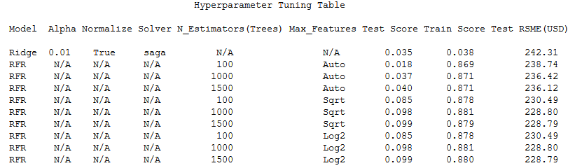
Results and In-Depth Analysis HyperParameter Tuning Table

Slide 16
Insights from Linear Regression Model
Using .coef_ on our Linear Regression model, I was able to find some interesting observations from the data.
The continuous variable “number of reviews” had a coefficient of approximately -0.18, meaning that for every review the listing has, you can expect the price of the listing to drop by approximately 18 cents. This matches some of the initial findings we found earlier, as listings with more visitors, tends to have lower prices. Prospective guests can filter out by this variable to find cheaper listings.
Another interesting continuous variable is “availability_365”. This variable counts how many days an AirBnB listing is available out of 365 days (a full year). Based on the coefficients, we can see that for every day an AirBnB is available to be rent out, out of 365 days, there is an increase of approximately 0.196 USD. This is very useful information to AirBnB hosts as this can help them determine how to choose the best price for their listings.

Slide 17
END

